Slide 1
Real Estate Revelations
The Power of Predictive Modeling
GROUP 10 DATA NERDS
David Gathimba
Juliet Mwaura
Branley Ope
Hannah Nduta
Joan Owuor
Linda Ng’eno

Slide 2
Introduction
In real estate, smart upgrades can make or break a sale. Imagine a tool that tells you which renovations boost property values the most.
Picture a real estate agent using advanced data analytics to effortlessly identify the best home improvements, ensuring every dollar spent significantly increases value.
Welcome to our real estate valuation project. We combine modern statistics with practical renovation needs. Our state-of-the-art linear regression models uncover hidden data gems, guiding you to the most profitable property enhancements.
Join us to turn guesswork into strategy, making homes beautiful and smart investments for the future.

Slide 3
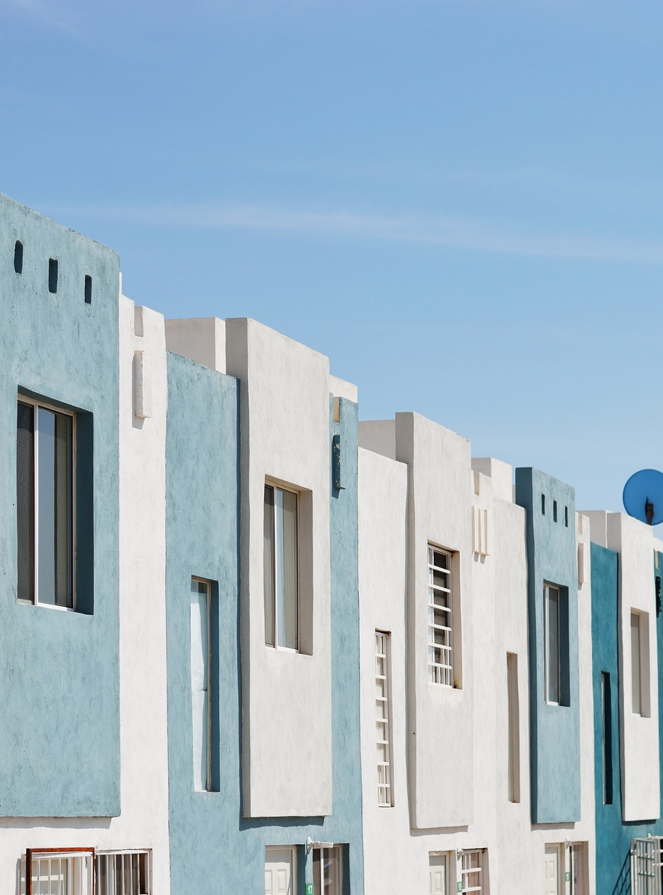
Problem Statement
Determining which home renovations most effectively increase property values is a challenge for real estate agencies, homeowners, and investors. Without data-driven guidance, resources may be allocated to improvements yielding suboptimal returns, leading to inefficiencies and missed opportunities.
This project leverages advanced linear regression models to identify key features and renovations that significantly impact home values. By providing clear, actionable insights, it empowers stakeholders to make informed decisions, optimize resources, and enhance property values.

Slide 4
OBJECTIVES
01
To analyze the relationship between various features and housing prices, as well as the interrelationships among these features.
Findings
Features that had a Strong Positive Correlations included grade (0.668376), sqft_above (0.605623), sqft_living (0.701542), multicollinearity issues, particularly between sqft_living, sqft_above, and grade.
Features that had a weak correlation included floors(0.256534), waterfront(0.25908), condition(0.034103) and zip code at (-0.052583).

Slide 5
OBJECTIVES
02
To develop a predictive model to estimate house prices based on various features.
Findings
The linear regression model combined grade, combined_sqft, yr_built, sqft_living15, bathrooms, view, sqft_lot15, bedrooms, sqft_basement and floors which attained a r2 of 0.65. This indicates that 65% variance of this indicators can be used to predict housing prices.

Slide 6
OBJECTIVES
03
To visualize data distributions and relationships between features using correlation matrices and pair plots with a focus on the following variables:
Bedrooms
Sqft_living
Waterfront

Slide 7
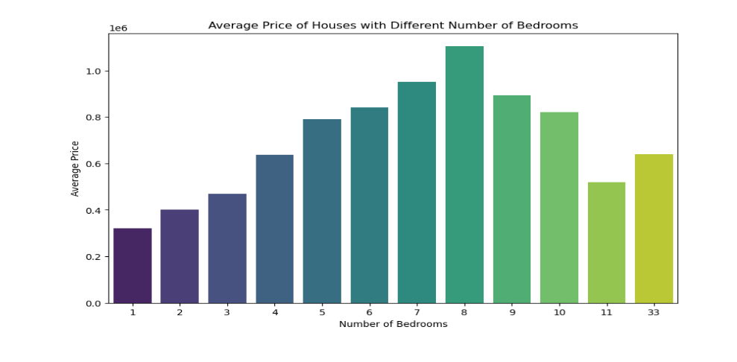
Price against number of Bedrooms
Houses with more bedrooms tend to have higher average prices, peaking at 8 bedrooms, after which the average price decreases. The significant deviation at 33 bedrooms suggests a different market segment for extremely large houses.
Notes:
X-Axis (Number of Bedrooms): This axis represents the number of bedrooms in a house. The numbers range from 1 to 33, with a notable gap between 11 and 33 bedrooms.
Y-Axis (Average Price): This axis represents the average price of houses in millions of dollars.
The chart shows the average prices of houses based on the number of bedrooms, ranging from 1 to 33. Key observations include:
1. Increasing Trend: Average prices rise from 1 to 8 bedrooms, peaking at 8 bedrooms.
2. Decreasing Trend: Prices drop after 8 bedrooms, with a notable decrease for houses with 11 bedrooms.
3. Outlier: Houses with 33 bedrooms have a higher average price than those with 11 bedrooms but lower than those with 8 bedrooms.
In summary, house prices generally increase with the number of bedrooms up to 8, after which they decline, with a significant price difference observed for houses with a very high number of bedrooms.

Slide 8
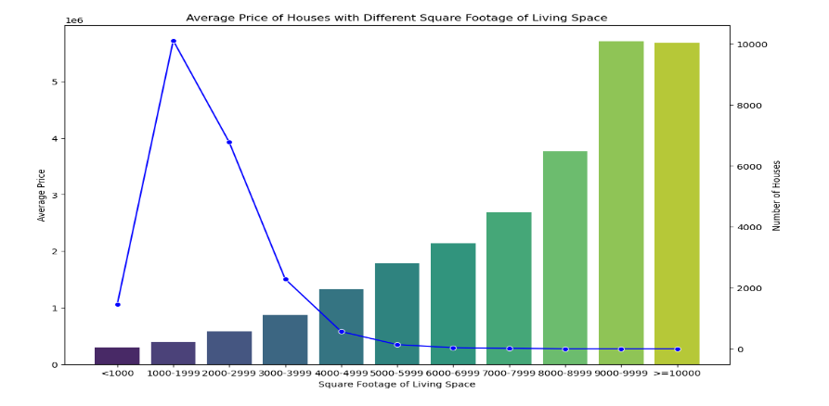
Price against size of Living space
Mid-sized houses (2000-2999 sq. ft.) have the highest prices, while larger houses are more common but have stabilized prices.
Notes:
This chart depicts the relationship between the average price of houses and their square footage of living space, as well as the number of houses within each square footage range.
X-Axis (Square Footage of Living Space): This axis categorizes the square footage of houses into ranges
Left Y-Axis (Average Price): This axis shows the average price of houses in millions of dollars.
Right Y-Axis (Number of Houses): This axis indicates the number of houses within each square footage range.
Bars (Number of Houses):
The height of the bars represents the number of houses within each square footage range.
The number of houses increases significantly as square footage increases, peaking at the 9000-9999 and >=10000 ranges, both exceeding 10,000 houses.
Line Plot (Average Price):
The line plot shows the average price of houses corresponding to each square footage range.
Houses with square footage of 2000-2999 have the highest average price, peaking at over $5 million.
After this peak, the average price sharply declines and then stabilizes for larger square footage ranges.
Price Trend: The average price of houses increases sharply from <1000 to 2000-2999 square feet, reaching a peak. Beyond this peak, the average price decreases and stabilizes for larger square footage ranges.
Key Insights:
High Demand for Mid-Sized Houses: Houses with 2000-2999 square feet command the highest average prices, indicating high demand or value for this size.
Stabilization in Larger Houses: Despite the increase in the number of large houses (>=10000 square feet), the average price stabilizes, suggesting a saturation point or different market dynamics for very large houses.

Slide 9
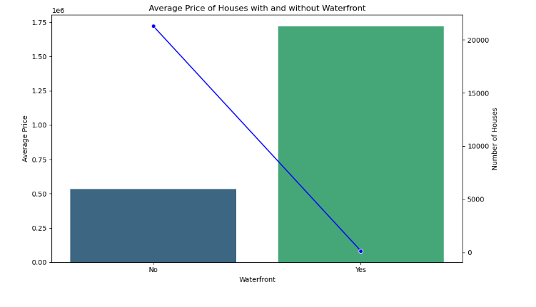
Price against Waterfront features
Waterfront houses command a significantly higher average price, but there are far fewer of them compared to houses without waterfront features.
Notes:
chart illustrates the average price of houses with and without waterfront features, along with the number of such houses
X-Axis (Waterfront): This axis categorizes houses into two groups: "Yes" for houses with waterfront features and "No" for houses without.
Left Y-Axis (Average Price): This axis shows the average price of houses in millions of dollars.
Right Y-Axis (Number of Houses): This axis indicates the number of houses in each category.
Bars (Number of Houses):
The height of the bars represents the number of houses with and without waterfront features.
There are significantly more houses without waterfront features than with them.
Line Plot (Average Price):
The line plot shows the average price of houses in each category.
Houses with waterfront features have a much higher average price, around $1.75 million.
Houses without waterfront features have a lower average price, around $0.5 million.
Price Comparison: Houses with waterfront features are significantly more expensive, averaging around $1.75 million, compared to houses without waterfront features, which average around $0.5 million
.House Count: There are many more houses without waterfront features compared to those with.

Slide 10
RECOMMENDATIONS FROM THE REGRESSION MODEL
01. Grade of the House (grade_numeric)
Improving the overall grade of the house, which represents the construction quality and design, can significantly increase the home's value. Grade of the house has the highest positive impact on the estimated value.
This can be achieved through high-quality renovations, modern designs, and premium materials.
Dollar Impact: $127,174.88, indicating that improving the grade of the house by one unit can increase its value by approximately 128,963.02,𝑤𝑖𝑡ℎ𝑎 95 123,002.54 to $131,672.33.
KING COUNTY DATA

Slide 11
Recommendations
Year Built (yr_built)
While the year built cannot be changed, focusing on modernizing older homes through renovations can mitigate the negative impact of an older construction date.
Emphasize updating essential systems like plumbing, electrical, and HVAC to meet current standards.
Increase Living Space:
03
Expanding the living area (sqft_living) or basement space (sqft_basement) can increase the home value.

Slide 12
THANK YOU
Unlock the true potential of your properties with
data-driven renovations.

